Slide 1


Project Pitch
Matei Mitran
Fontys S6 Enterprise Software

Slide 2
YouSound – Music Streaming Service
Application to upload and listen to music and interact with music communities.
Some key features are:
Listen to music as a listener
Upload music and build your artist community as an artist
Monitor the platform as an administrator
Interact with other listeners in your favorite artist’s community

Slide 3
Challenges
Scalability
Maintainability
Security
Data Management

Slide 4
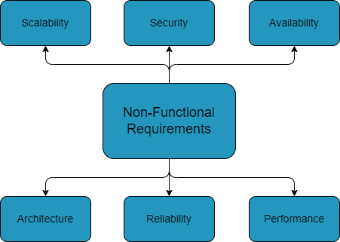
Non-Functional Requirements

Slide 5
Architecture
NextJS Typescript Frontend
Java Springboot Backend
Testing: Cypress for E2E testing and JUnit and Mockito for unit tests and acceptance test
Microservice architecture with message broker and API gateway

